Slide 1
Social Media App
By Rania Deiri

Slide 2
Login Page

Slide 3
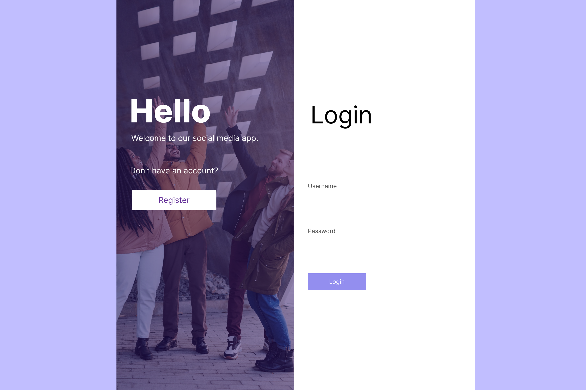

Slide 4
Register

Slide 5
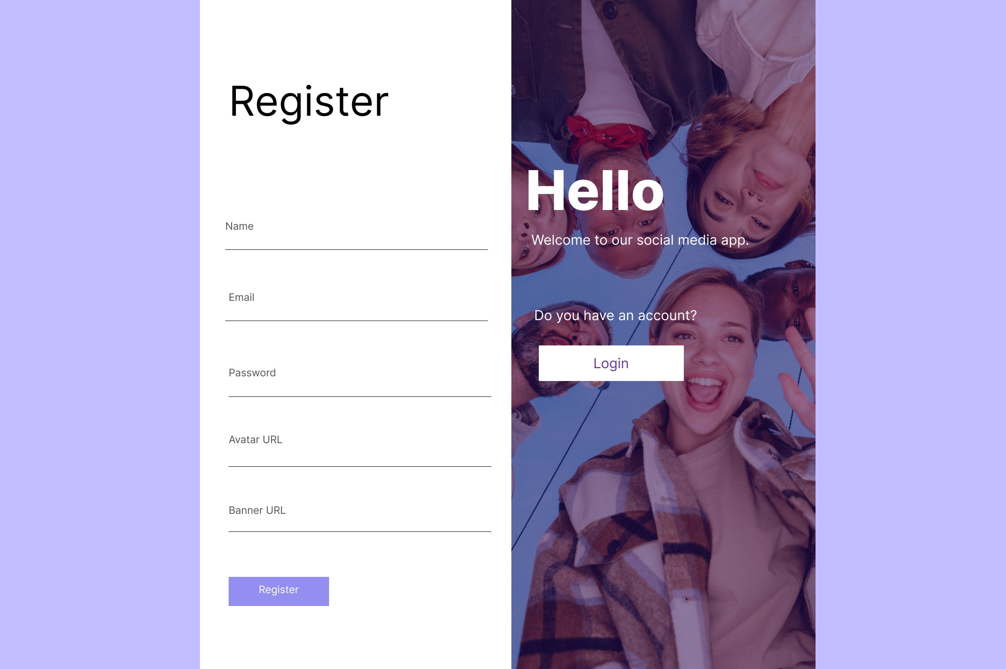

Slide 6
Home

Slide 7
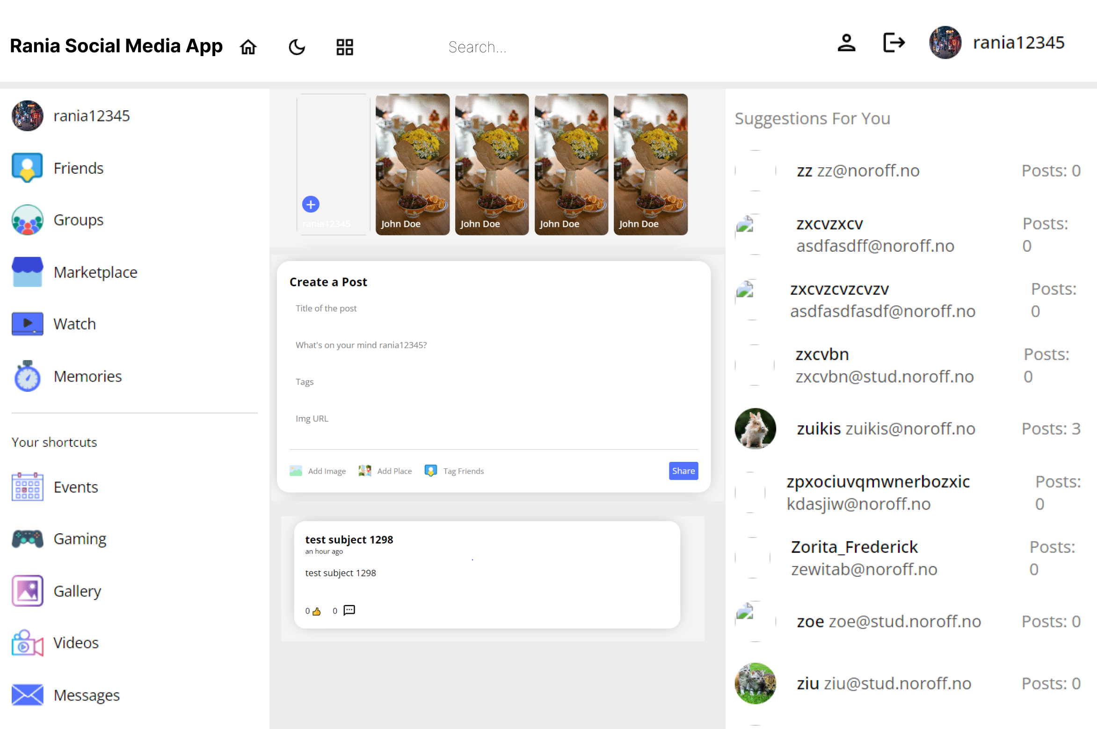

Slide 8
Edit a Post

Slide 9
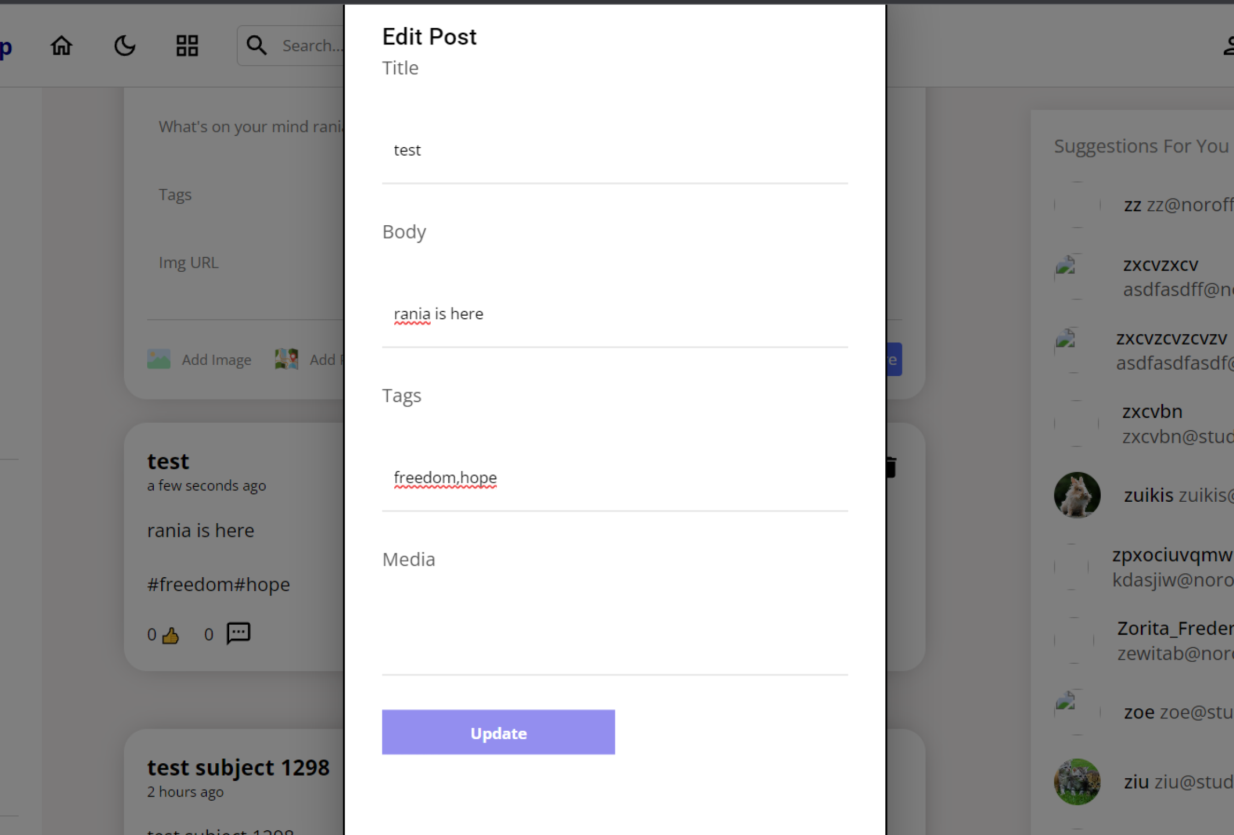

Slide 10
Dark Theme

Slide 11
